Slide 1
Speaker Identification
모델 구조
실험 결과

Slide 2
Base code reference SSSC(Statistical Speech and Sound Computing) Lab URL: https://github.com/jymsuper/SpeakerRecognition_tutorial
CNN
(resnet18)
Avg pooling
FC layer
Feature
output
전처리
github: filter bank
실험: mel-cepstrum

Slide 3

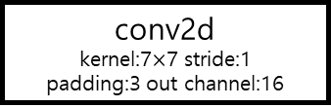
Model
(batch size, channel, dim, win)
input
(N batch size, 1 channel, 40 dim, 100 win)
conv2d
kernel:7$×$7 stride:1
padding:3 out channel:16
avg pooling
(N, 128)
(N, 16, 40, 100)
FC
BatchNorm2d
(N, 128)
ReLU
ReLU
Layer1
in channel:16 / out channel:16
FC
(N, 16, 40, 100)
(N, num of speaker)
Layer2
in channel:16 / out channel:32
1
2
$$⋯$$
m
(N, 32, 10, 25)
Layer3
in channel:32 / out channel:64
(N, 64, 3, 13)
Layer4
in channel:64 / out channel:128
(N, 128, 1, 4)

Slide 4
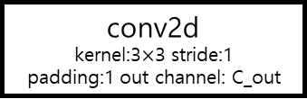
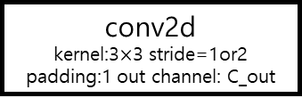
Layer1
Layer2
Basic Block
input
(N, 16, H, W)
input
(N, 16, H, W)
input
(N, C_in, H, W)
Basic Block
Basic Block
conv2d
kernel:3$×$3 stride=1or2
padding:1 out channel: C_out
(N, 32, H/2, W/2)
Basic Block
Basic Block
BatchNorm2d
output
(N, 16, H, W)
output
(N, 32, H/4, W/4)
ReLU
conv2d
kernel:3$×$3 stride:1
padding:1 out channel: C_out
Layer3
Layer4
input
(N, 32, H, W)
input
(N, 64, H, W)
BatchNorm2d
Basic Block
Basic Block
(N, 64, H/2, W/2)
(N, 128, H/2, W/2)
ReLU
Basic Block
Basic Block
output
(N, C_out, H’, W’)
output
(N, 64, H/4, W/4)
output
(N, 128, H/4, W/4)

Slide 5
Data set
VCC2016
- train: SF1, SF2, SF3, SM1, SM2, TF1, TF2, TM1, TM2, TM3 / 각 화자마다 162개 데이터, 총 1620개 데이터
- validation: train set의 10% (=162개, train은 1458개로 진행)
- test: SF1, SF2, SF3, SM1, SM2, TF1, TF2, TM1, TM2, TM3 / 각 화자마다 54개 데이터, 총 540개 데이터

Slide 6
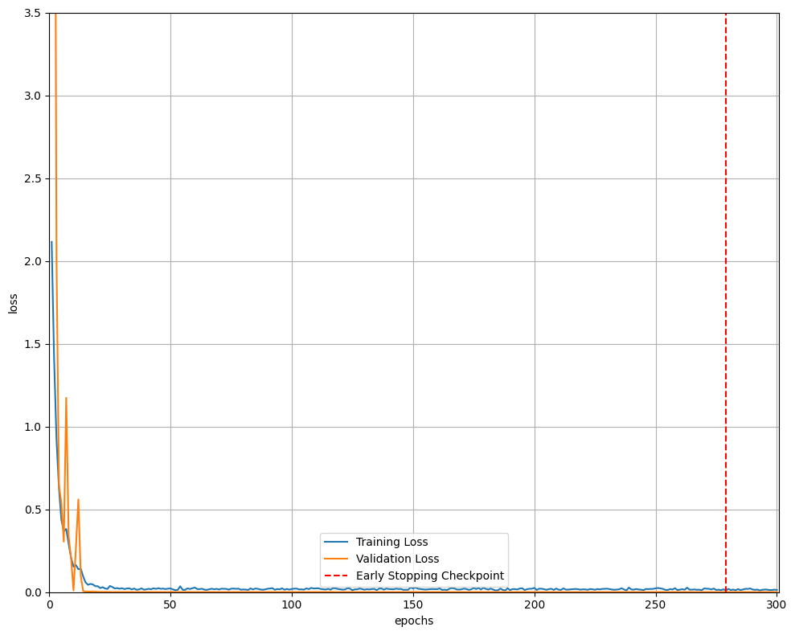
epoch: 300
train batch size: 64
validation batch size: 16
min check point: 279
optimizer: sgd
initial learning late: 1e-1
weight decay: 1e-4

Slide 7
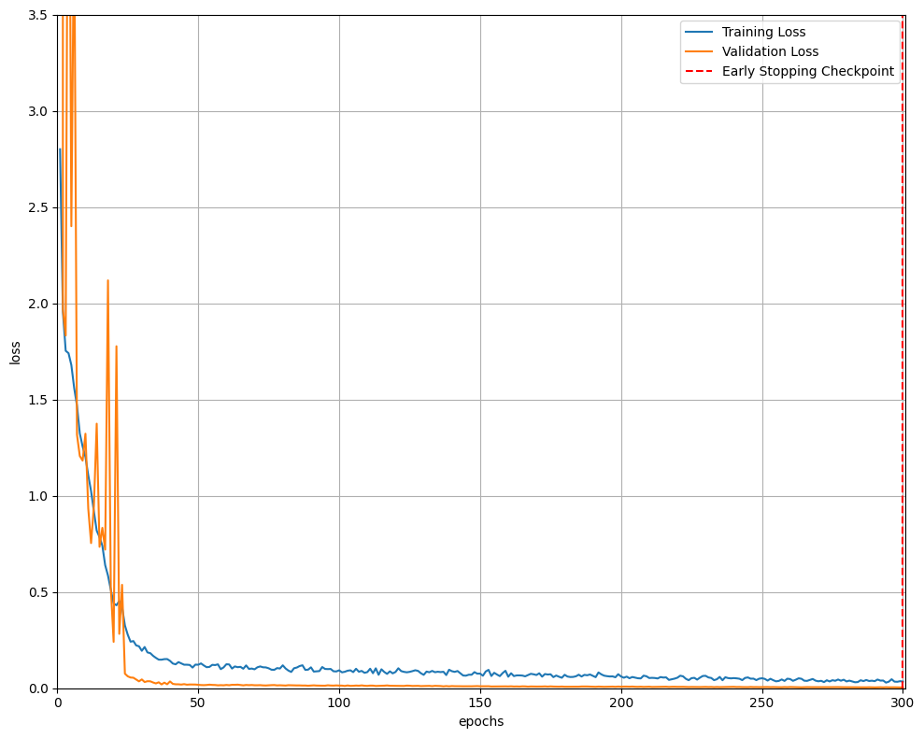
epoch: 300
train batch size: 64
validation batch size: 16
min check point: 300
optimizer: adam
initial learning late: 1e-1
weight decay: 1e-4

Slide 8
Speaker | soft | hard
SF1 | 54 / 54 | 54 / 54
SF2 | 53 / 54 | 54 / 54
SF3 | 54 / 54 | 54 / 54
SM1 | 54 / 54 | 54 / 54
SM2 | 53 / 54 | 54 / 54
TF1 | 54 / 54 | 54 / 54
TF2 | 54 / 54 | 54 / 54
TM1 | 53 / 54 | 53 / 54
TM2 | 54 / 54 | 53 / 54
TM3 | 54 / 54 | 54 / 54
total | 537 / 540 | 538 / 540
acc(%) | 99.44 | 99.63
Speaker | soft | hard
SF1 | 53 / 54 | 54 / 54
SF2 | 50 / 54 | 54 / 54
SF3 | 47 / 54 | 53 / 54
SM1 | 50 / 54 | 53 / 54
SM2 | 49 / 54 | 54 / 54
TF1 | 52 / 54 | 54 / 54
TF2 | 45 / 54 | 54 / 54
TM1 | 52 / 54 | 53 / 54
TM2 | 51 / 54 | 52 / 54
TM3 | 53 / 54 | 53 / 54
total | 502 / 540 | 534 / 540
acc(%) | 92.96 | 98.89
[ sgd ]
[ adam ]

Slide 9
batch size | soft | hard
32 | 535 / 540 | 536 / 540
64 | 537 / 540 | 538 / 540
96 | 534 / 540 | 536 / 540
128 | 538 / 540 | 537 / 540
[ sgd ]

